Slide 1


Troubleshooters
Analog
Project
Audio Voice-over Circuit

Slide 2


Introduction
Our project was the design of an analog audio voice over circuit.
The main functionality of the device is to switch between audio from 2 channels and output it using a speaker.
The switching happens automatically using a switching IC.
Normal audio is from a 3.5mm jack and microphone is given priority when it is used.
Our top priority was to ensure the clarity of the output sound by removing any induced noise.

Slide 3
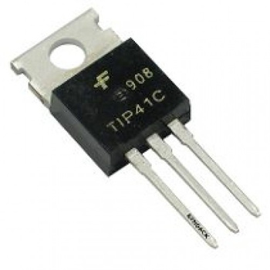
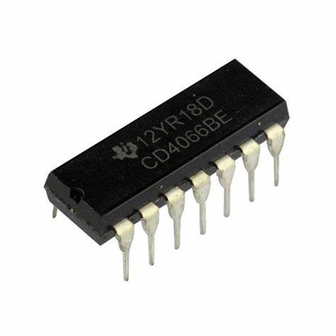
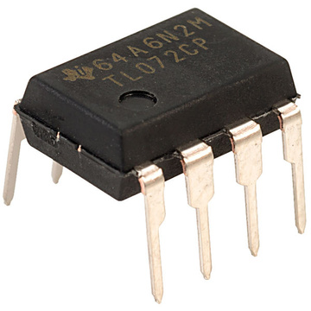
Components
Opamp - TL072
Power Transistors - TIP41, TIP42
Diodes - 1N4148
Capacitors/ Resistors
Electret Microphone
CD4066 Switching IC
LM7812/ LM7912 Voltage Regulators

Slide 4


Justification for Components
TL074 Opamps - High slew rate (13V/µs)
Low Noise Amplification (Low input offset / bias current)
High bandwidth (3MHz Unity gain bandwidth)
TIP41/TIP42 Transistors - High power dissipating capability (65W)
High collector current to drive the speaker (Upto 6A)
1N4148 Diode - High reverse volage (75V)
Low reverse recovery time (4ns)
CD4066 Switch IC - CMOS bilateral switches
Logical switching unlike mechanical switching relays
No noise like relays
Minimal Distortion
IN5408 Diode - High peak repetitive reverse voltage (1000V)
High surge current capability (200A)

Slide 5

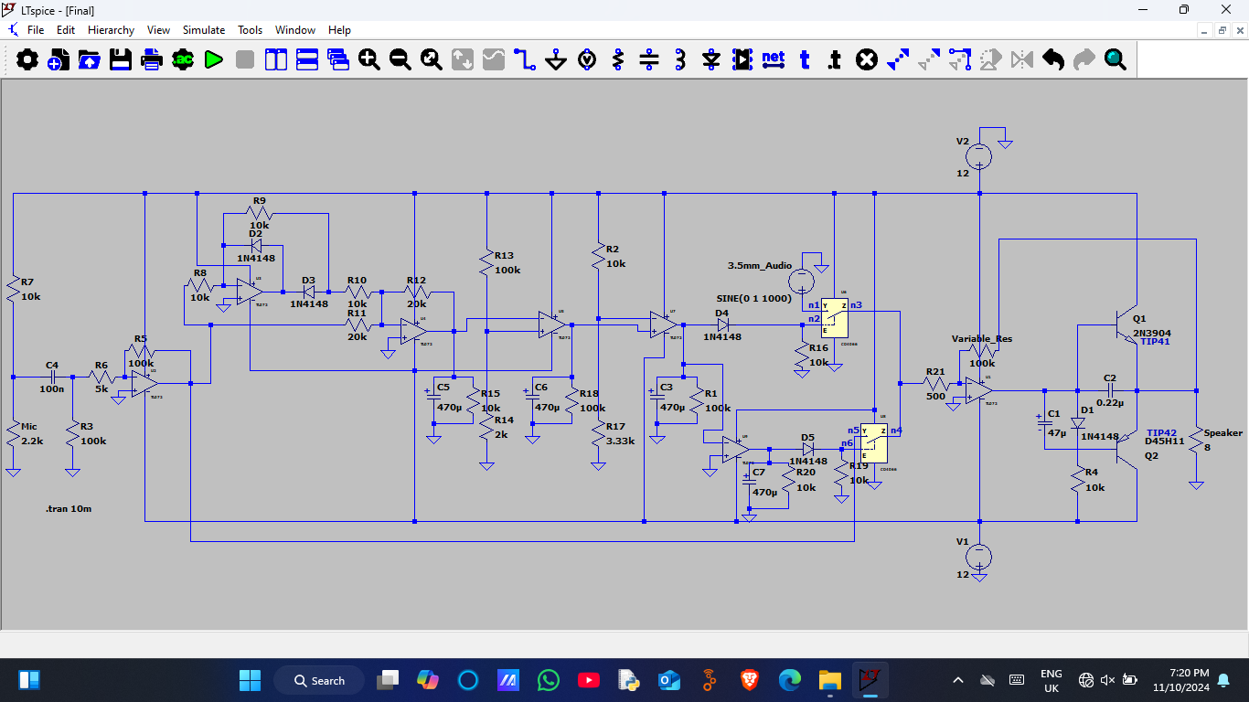

Schematic

Slide 6
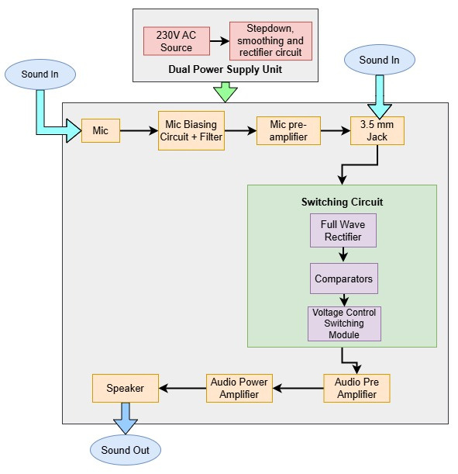
Device Architecture
Main Parts of the Circuit
1. Microphone Biasing and Preamplifier
2. Full wave rectifier circuit
3. Switching circuit
4. Audio Preamplifier
5. Audio Power Amplifier
6. Power supply circuit
.

Slide 7
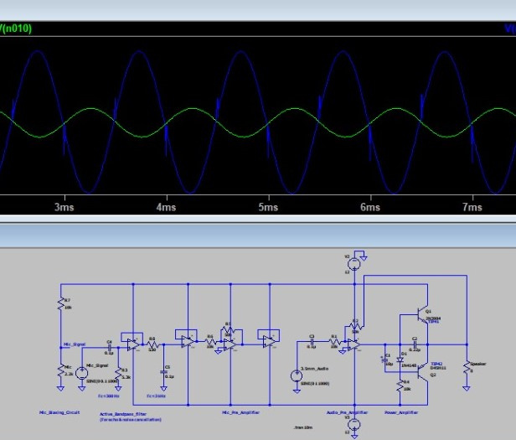
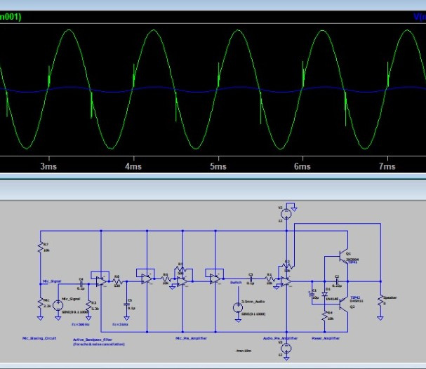

Simulation Results
Input From Microphone
Input From Microphone

Slide 8

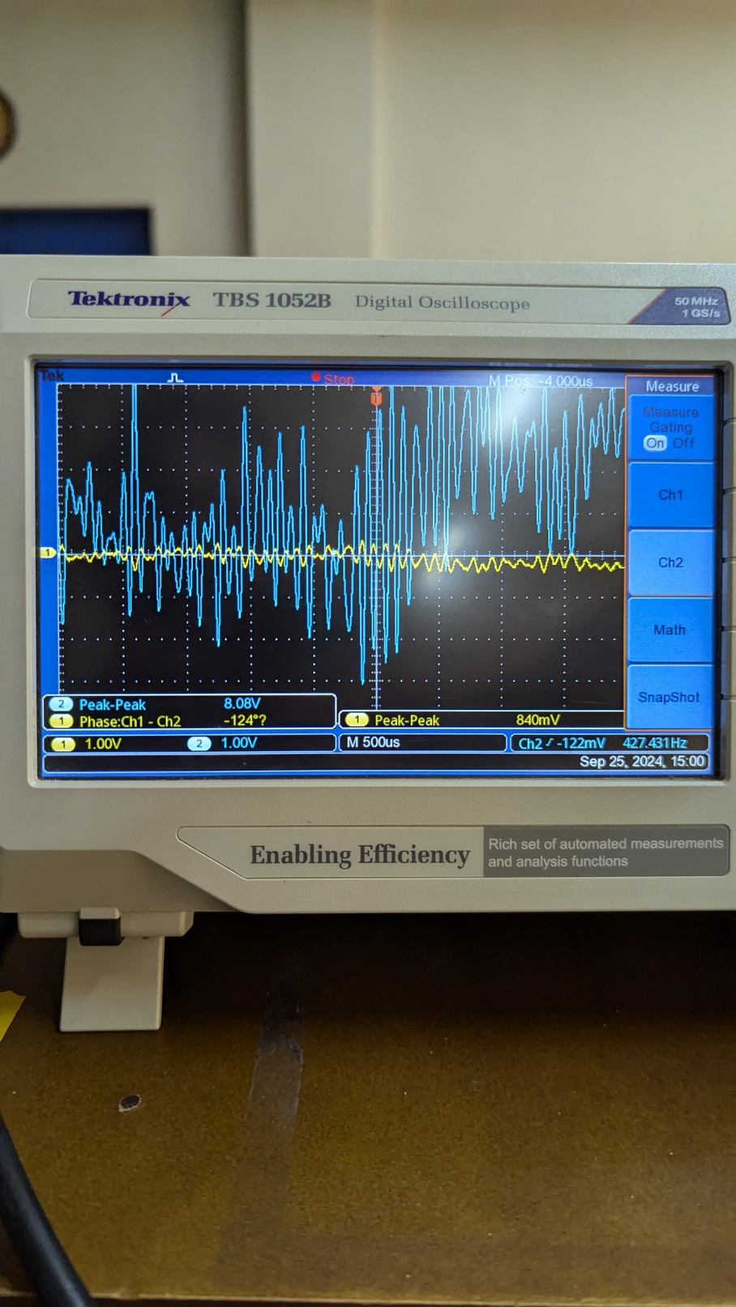
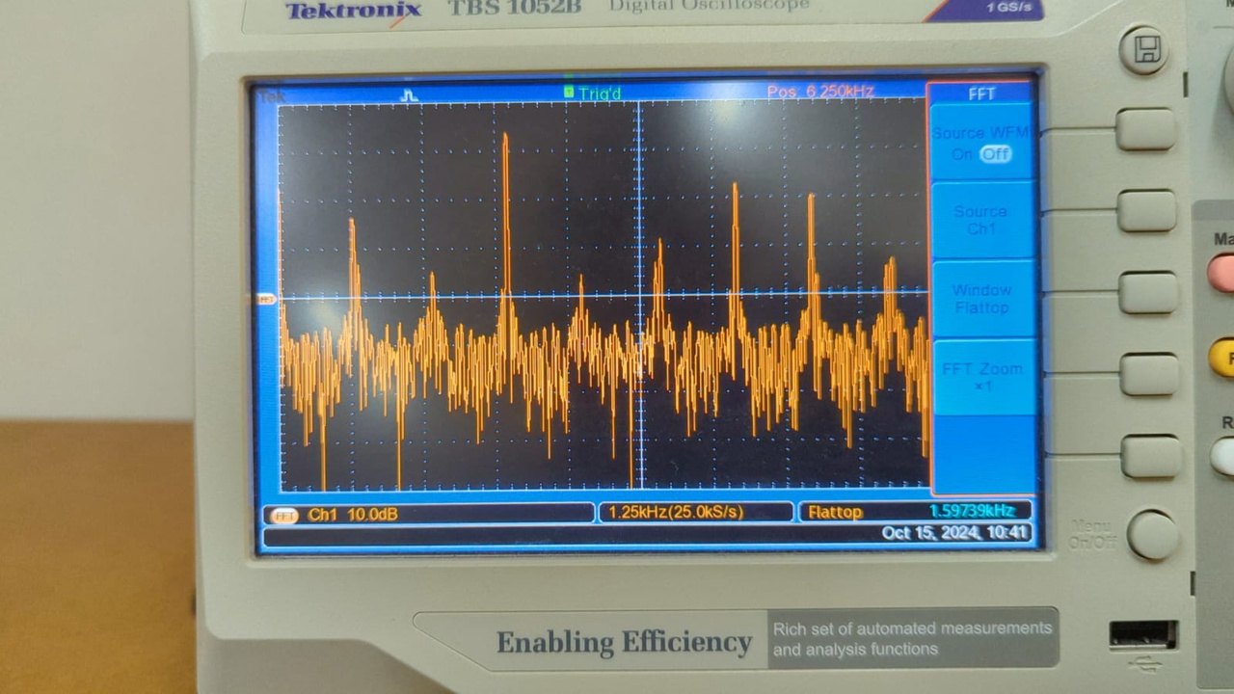
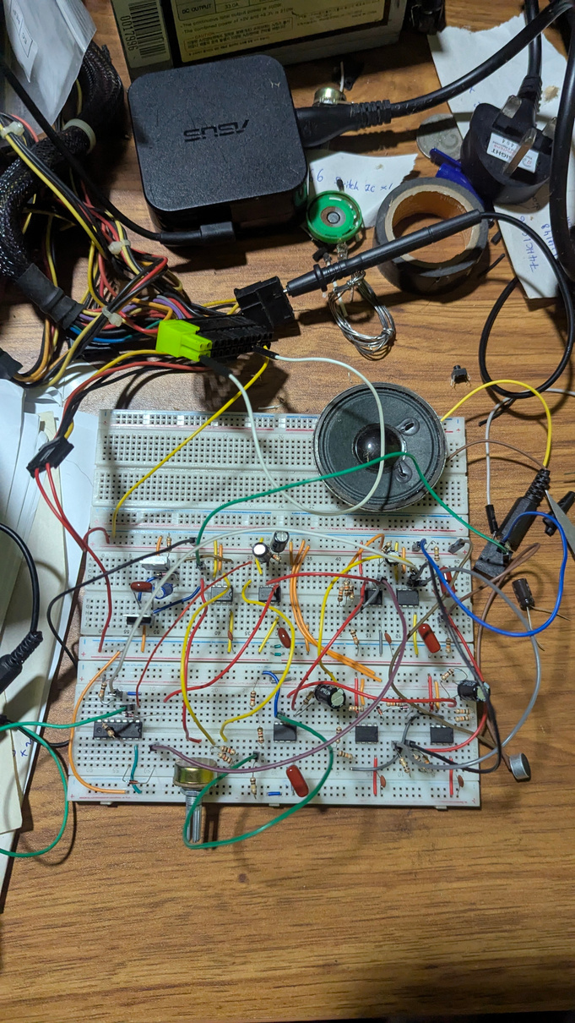
Prototype
3.5mm Audio Output
Echo Spectrum
The Breadboard Implementation

Slide 9

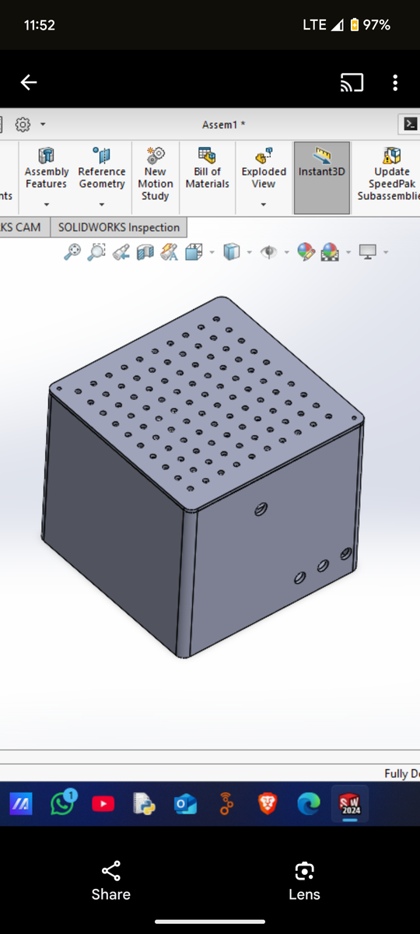
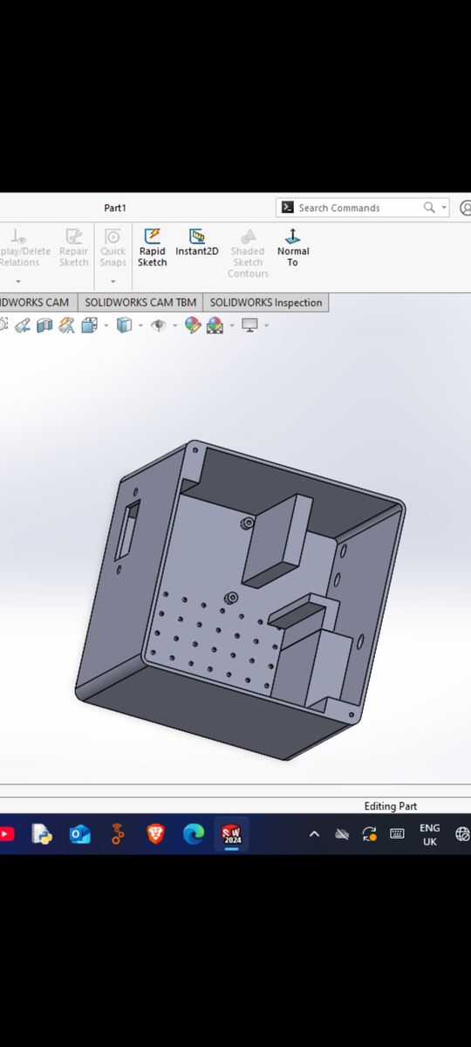
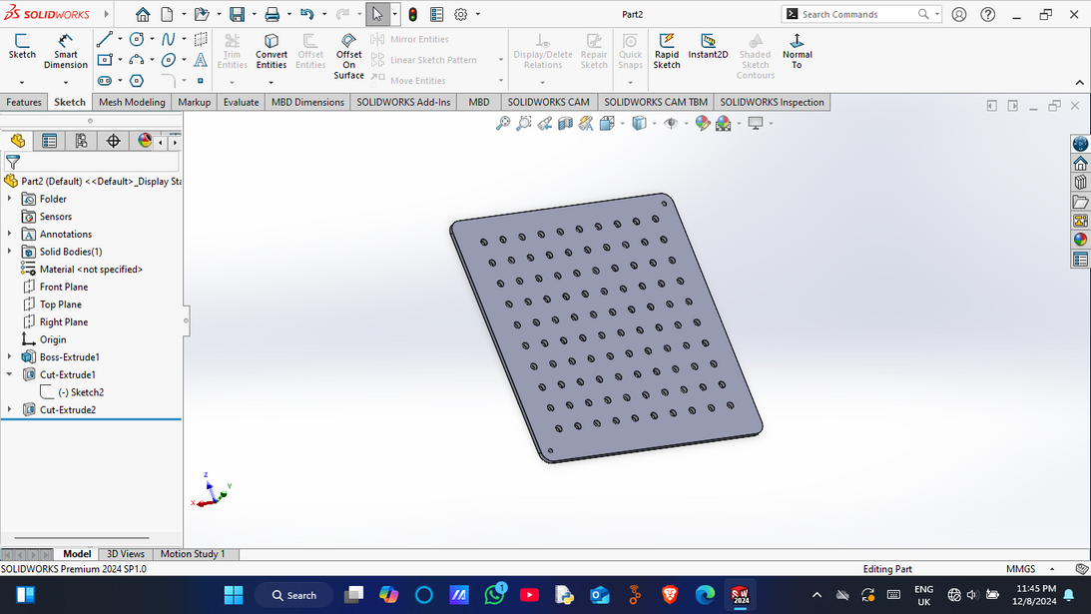
Enclosure Design
Enclosure design objective is to provide a compact, durable and ventilated enclosure for our product.
Designed using black PLA.
Very simple design with three IO ports holes, power socket hole & volume controller hole.
Perforations on the top & bottom panels to prevent overheating.
Final design dimensions - 11.6×11.6×10 cm

Slide 10
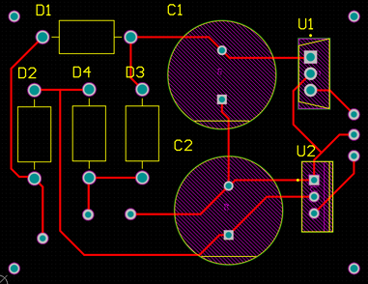
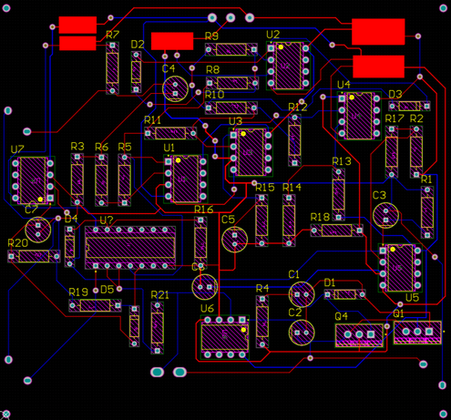
PCB Design
We designed and printed 2 PCBs for the project.
Main PCB was for the voice over circuit.
It was a dual layer PCB with 93 mm × 100 mm dimensions.
A smaller PCB was designed to supply dual voltages needed for the circuit.
It was single layer with the dimensions 43.5 mm × 57 mm.
Power PCB
Main PCB

Slide 11
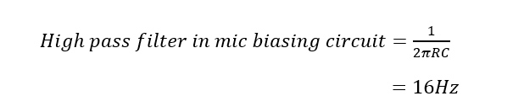
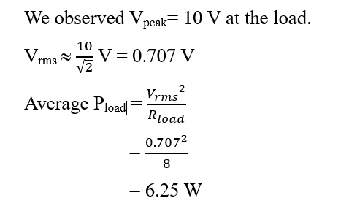
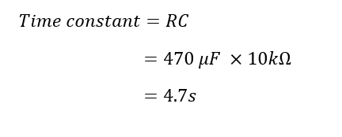
Calculations
Filter effect in microphone input circuit
Power Calculation
Time to discharge smoothing capacitors

Slide 12
Future Improvements
Use both wall power and a battery in unison so the device can be used without wall power for some time.
Improve the signal fidelity of the PCB.
Implement equalizers to control different qualities of the audio.
Make the enclosure more ergonomical and attractive.

Slide 13
Bill of Materials
Component
Amount
Price (Rs.)
Resistors
Capacitors
TL072 Opamp
TIP41/TIP42 Transistors
CD4066 Switching IC
IN4148/IN5408 Diodes
PCB
Enclosure
LM7812/LM7912 Regulator
Transformer
25
9
7
2
1
9
2
1
25.00
220.00
350.00
100.00
50.00
100.00
8000.00
4500.00
120.00
2000.00

Slide 14





Task Allocation
Peries P.I.U
220452H
Viduranga J.K.A
220663F
Jayasekara S.P.R
220257N
Weerakoon W.M.B.H
220683P
Circuit Design
Simulation
Testing and Debugging
Enclosure Design
Resource Management
Circuit Design
Testing and Debugging
PCB Design
PCB Testing
Documentation

Slide 15
Thank
You

